Slide 1
FARMERS BUDDY
Anjali Sharma(18BTL140302)
Shivam Thakur(17BT140301)
Under the guidance of Mrs. Divya Jyoti B.Tech

Slide 2
Introduction
This is the agricultural portal which provides solutions to small farmers and
agricultural students.
It also helps the NGO’s to get valuable information regarding soil and
fertilizers and also crops.
It also helps the agricultural students to get practical information regarding
various crops.
It also helps the farmers through ngo’s to get information regarding soil, crops
in awareness programs being conducted in villages.

Slide 3
Objective
The main objective of the project is to provide information to the farmers and
agricultural students.
It provides better solutions for farmers in providing the information regarding soils,
fertilizers.
It helps the users in getting training regarding various technologies that can be used
in farming.

Slide 4
Existing System
Complexity in managing the data related to agricultural products , soils, fertilizers,
and market details
Lack of security
This system doesn’t provide category wise classification of products.
Inefficiency in querying details.
Periodic report generation takes lot of time

Slide 5
Proposed System
The development of this new system contains the following activities, which try to automate
the entire process keeping in the view of database integration approach.
Reduce complexity in managing the data related to agricultural products , soils,
fertilizers, market details.
Current system provides different access levels for security.
Rich user interface is provided in order to interact with application.
Reports are generated dynamically on a periodic basis.
Efficiency in querying details.
User queries and answers are maintained.

Slide 6
Specific Requirements
Functional Requirements:
Individual profile management for all kinds of users.
Basic soil analysis for all regions and suggestions on which fertilizers to use
where and how much? Which crop, herb or vegetable can be grown where and
in which season?
Online query handlings for all users. Queries can be directed to a particular
officer.
Officers/ngo’s can schedule trainings and publish it online.
Facilitate communication between user and general public through mails.
Information about major crop markets and their current price for crop should be
published daily.
Information pages should be dynamic .

Slide 7
Non Functional Requirements:
Secure access of confidential data(user’s details).
Better component design to get better performance at peak time.
Flexible service based architecture will be highly desirable for future extension.
User Interface Requirements:
Professional look and feel.
Browser testing and support for IE.
Reports exportable in .XLS, or any other desirable format.

Slide 8
Use Case Diagram:

Slide 9
Class Diagram:

Slide 10
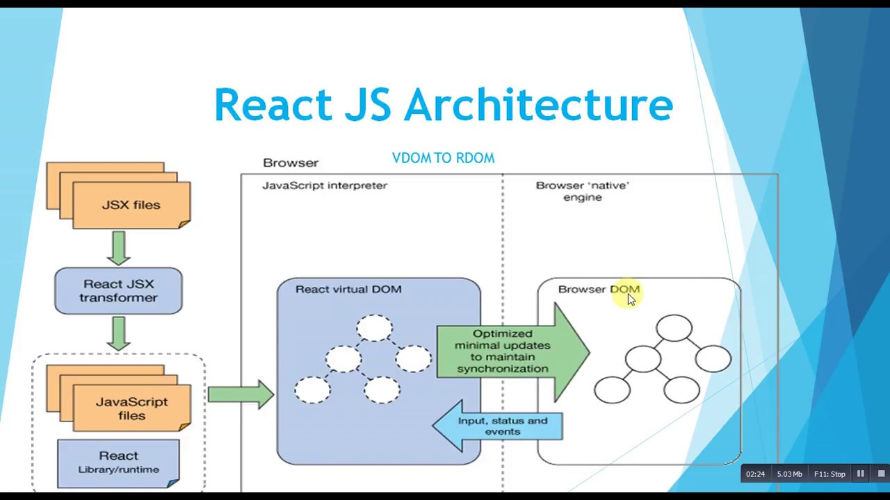
System Architecture Diagram:

Slide 11
System Requirements
Software Requirements:
Operating System : Windows XP/2003 or Linux
User Interface : HTML, CSS, React
Client-side Scripting : JavaScript
Programming Language : React js
Database : MySql
Server Deployment : Apache
Hardware Requirements:
Processor : Pentium IV
Hard disk : 40GB
RAM : 512MB or more

Slide 12
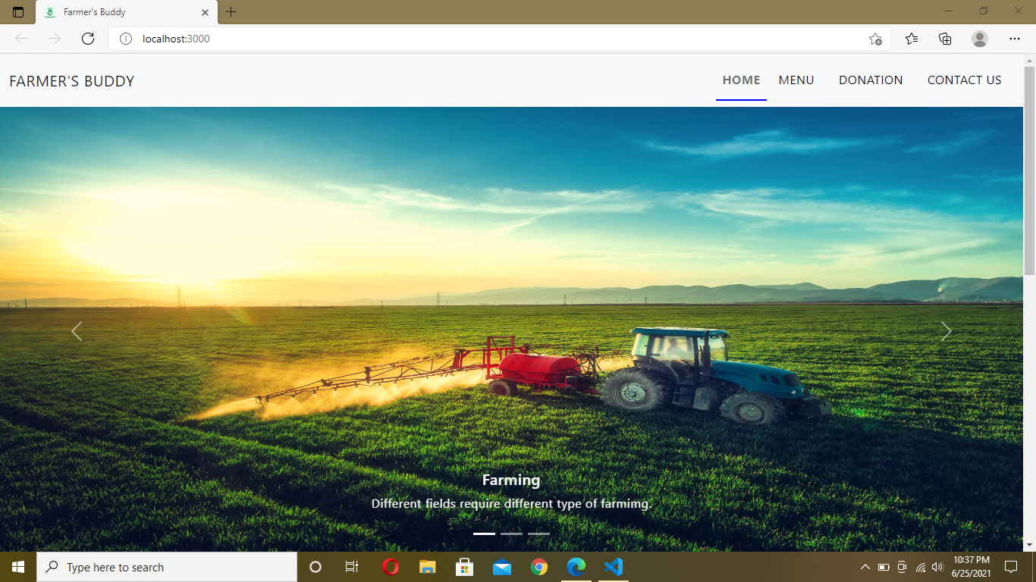
Screen Shots Of Farmers buddy:
1) Home Page

Slide 13
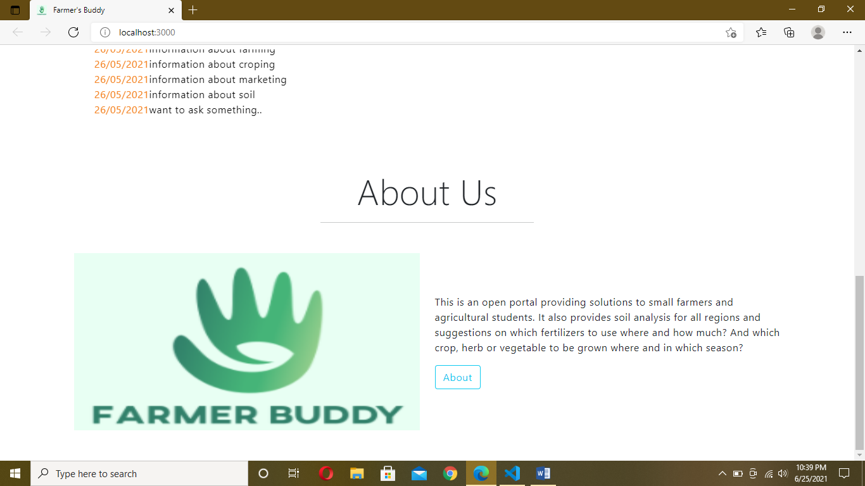
2) About Us

Slide 14
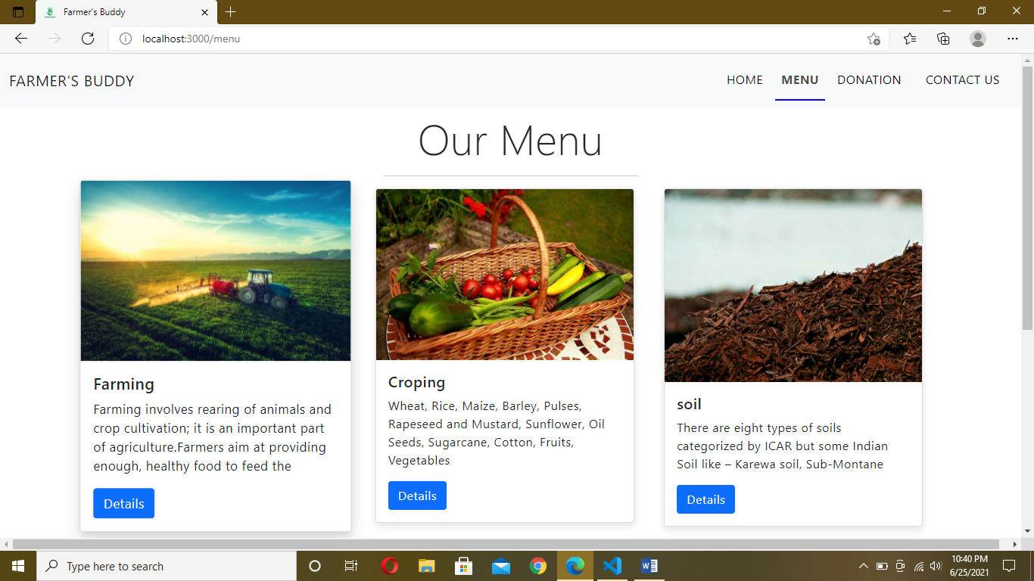
3) Our Menu

Slide 15
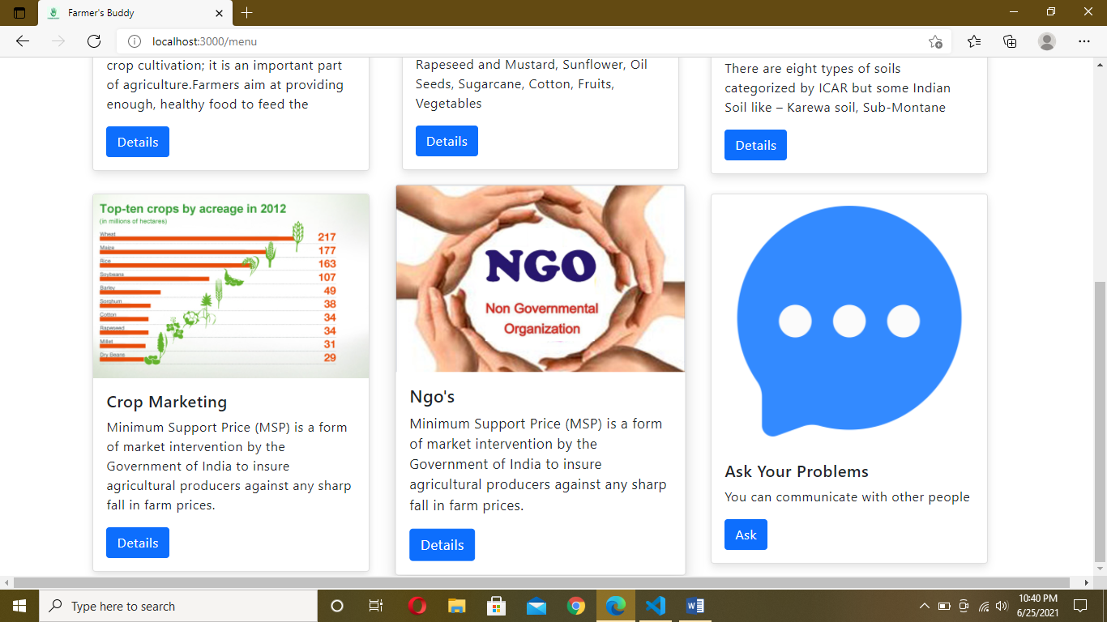
3) Our Menu

Slide 16
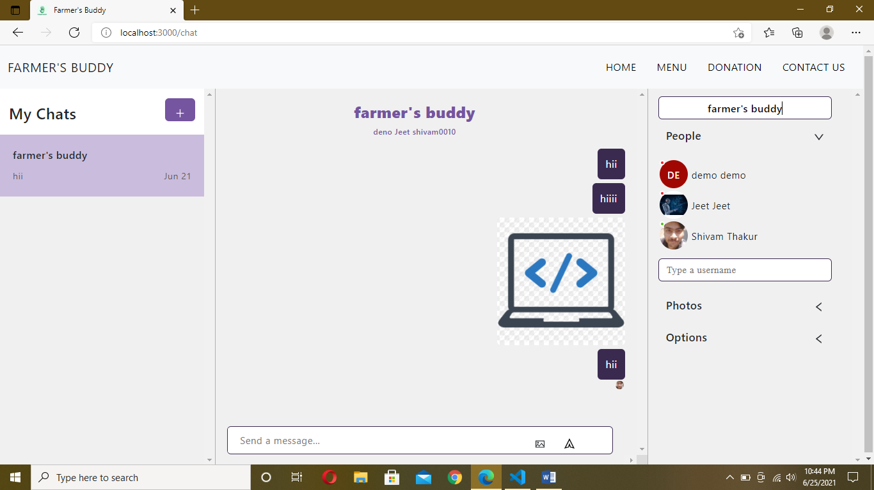
4) Chat Section

Slide 17
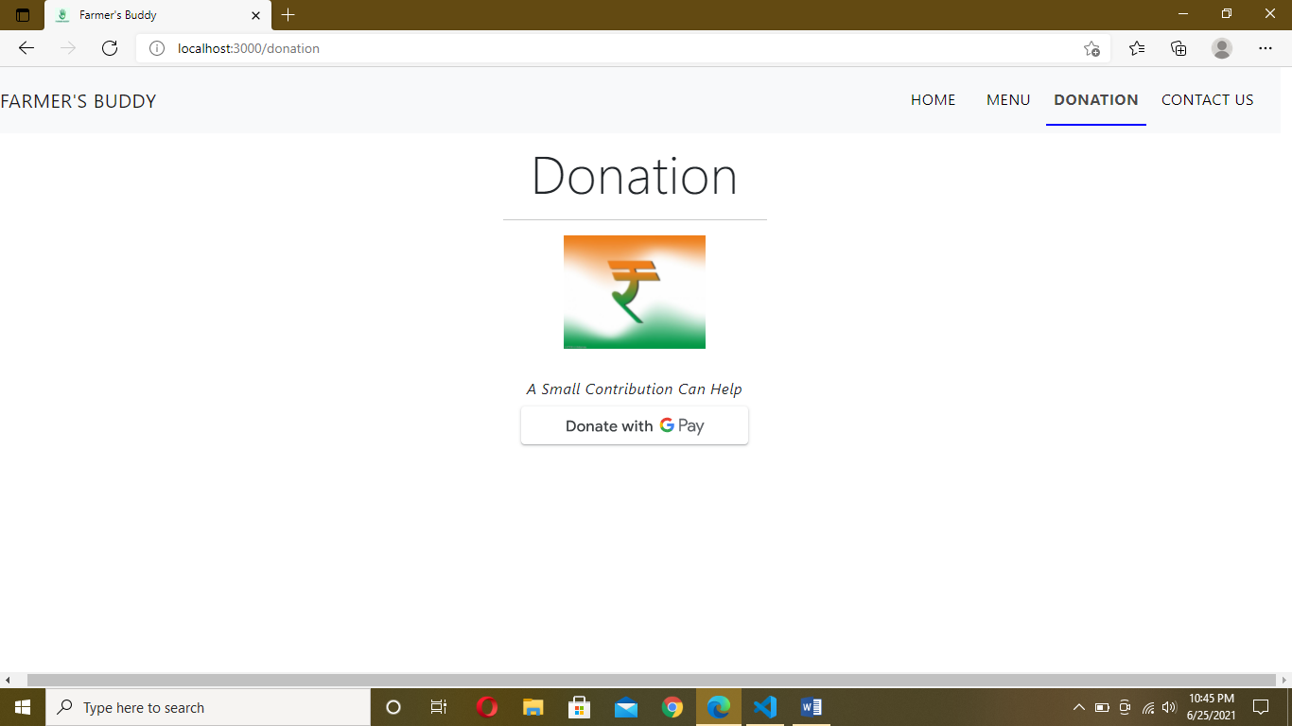
5) Donation

Slide 18
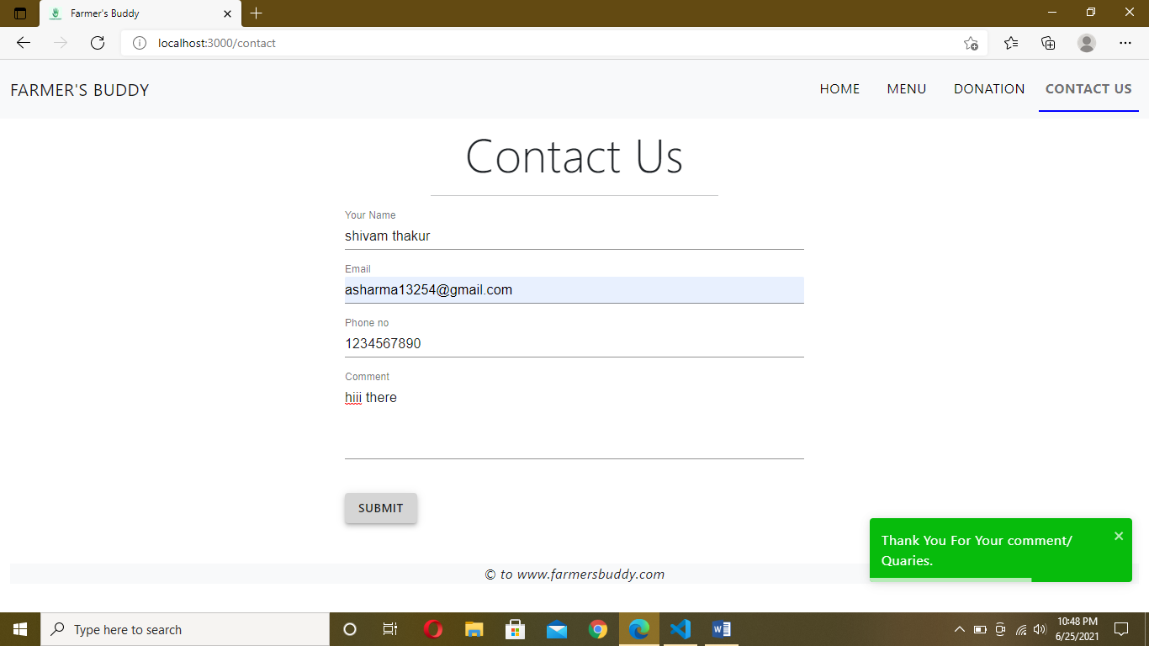
6) Contact us

Slide 19
Strengths:
Good look and feel
It provides valuable and valid information regarding soils, crops and fertilizers
Training facilities are also provided for users regarding technologies that can be
used in farming.
The users can also post their queries regarding any of the information that can be
answered by the officers.
Weakness:
Doesnot support local languages.
Not directly useful for farmers

Slide 20
Conclusion:
By this project, we provide various information regarding soil, crops, fertilizers
for farmers and also for the agricultural students.
It also solves various queries posted by the users.
It makes agriculture more eco-friendly.

Slide 21
Thank You

